Slide 1

GOKARAJU RANGARAJU INSTITUTE OF ENGINEERING AND TECHNOLOGY
Department of Computer Science and Engineering
Major Project Review-2
FixMyCity: Smart Civic Issue Reporting and Urban Decision Support System
Under the esteemed guidance of
Dr P Varaprasad Rao
Professor
BUVANESH NEERUKONDA - 23241A05T4
Batch No: E8 P.MANIKANTA REDDY - 23241A05X2
PULI ANIRUDH - 23241A05X3
SHAIK ASHARAF - 23241A05X9

Slide 2
Project Overview & Objectives
Problem Statement
Citizens often lack transparent, centralised visibility into complaint progress, departmental actions, and resolution status.
Existing civic grievance systems primarily focus on complaint registration and tracking, with limited intelligent analysis.
Municipal authorities have limited tools to analyze spatial patterns, recurring issues, and seasonal civic problems.
Environmental challenges such as air pollution and water scarcity require integrated data analysis and predictive decision support.
Scope
Develop a Smart civic reporting and urban decision support platform for Hyderabad.
Enable citizens to report through Web and WhatsApp using text, images, voice, and location.
Combine citizen reports with AQI, weather, rainfall, satellite, land-use, and groundwater datasets.
Provide predictive insights and recommendations for pollution control, seasonal issue management, and sustainable water planning.

Slide 3
Objectives
Automatically classify and verify civic complaints using AI-based multimedia analysis.
Detect duplicate complaints using text, image, and geospatial similarity.
Prioritise issues based on severity, public support, affected population, and environmental impact.
Identify civic hotspots and recurring patterns using GIS and spatial-temporal analytics.
Predict air pollution and seasonal civic risks using environmental and historical complaint data.
Estimate water scarcity and groundwater recharge potential using rainfall, vegetation, land-use, and groundwater data.
Propose recommendations to support proactive municipal planning and resource allocation.

Slide 4
Introduction & Motivation
Introduction
Rapid urbanization and population growth have increased civic challenges such as road damage, waste accumulation, drainage issues, pollution, and water scarcity. Managing these problems efficiently requires continuous coordination between citizens and municipal authorities.
Municipal authorities need to efficiently report, analyze, prioritize, and resolve civic issues while understanding their broader impact across the city. FixMyCity explores AI-powered urban intelligence to assist authorities in analyzing citizen complaints, environmental data, spatial patterns, and seasonal trends for proactive decision-making.
Motivation
Improve citizen participation by providing accessible channels to report issues.
Reduce municipal response time by automation of internal tasks.
Enable proactive environmental management by combining complaints with AQI, weather, rainfall, satellite, land-use, and groundwater data to analyze pollution and water-related risks.
Support data-driven municipal planning through analyzing complaints and historical data.

Slide 5
Literature Survey Overview
Literature Survey Statistics
Total papers reviewed: 25
Publication period: 2021–2026
Major research areas: Civic complaint management and citizen sensing, smart-city platforms, road-damage detection and prioritisation, NLP/multimodal similarity, GeoAI and GIS-based urban analytics, air-quality forecasting, seasonal flood-risk prediction, groundwater prediction, explainable AI, and multilingual AI
Datasets identified across papers: FixMyStreet, 311 Service Requests, RDD2022 (Road Damage), OpenStreetMap (OSM), Sentinel-2, ESA WorldCover, SRTM DEM, CPCB Air Quality Data, OpenAQ, IMD Gridded Rainfall, India Flood Inventory (IFI), CGWB Groundwater Data, India-WRIS, Census of India, and IndicTrans2.
Algorithms/Models studied: Deep learning, YOLO/UNet, Sentence-BERT, CLIP, XGBoost, Random Forest, LSTM/hybrid deep learning, GCN/GNNExplainer, cosine-similarity methods, Whisper, and IndicTrans2.
Common evaluation metrics: Accuracy, Precision, Recall, F1-Score, mAP, IoU, MAE, RMSE, R², forecasting error, spatial analysis, response/resolution efficiency, and citizen-engagement measures.

Slide 6
Papers by Research Area
Civic Issue Reporting & Smart Governance — 6
Computer Vision & Infrastructure Monitoring — 3
NLP, Multimodal & Citizen Interaction — 3
GIS / GeoAI & Spatial Urban Analytics — 3
Air Quality & Pollution Prediction — 3
Water, Flood & Groundwater Intelligence — 5
Explainable AI & Decision Support — 1
Multilingual AI & Speech Processing — 1
Papers by Method
Classical Machine Learning & Ensemble / Forecasting Models — 7
AI / Deep Learning & Computer Vision — 5
Citizen-Sensing & Workflow-Based Systems — 4
GIS / GeoAI-Based Approaches — 3
NLP / Embeddings / Multilingual AI — 3

Slide 7
Key Mechanisms & Methodologies
Methodology | Purpose | Advantages | Limitations
Complaint Classification [1], [8] | Categorize citizen complaints using text/image information | Faster routing and reduced manual effort | Requires representative training data
Multimodal Similarity & Duplicate Detection [4], [5] | Identify semantically, visually, and geographically similar reports | Prevents duplicate counting and improves data quality | Similar reports may have different wording/images
Complaint Prioritization [3], [14] | Rank issues using severity, impact, engagement, and location | Supports efficient resource allocation | Depends on quality of priority factors
GIS & Spatial-Temporal Analysis [6], [7], [14], [16] | Detect hotspots and recurring geographic patterns | Enables location-based planning | Requires accurate spatial and temporal data

Slide 8
Methodology | Purpose | Advantages | Limitations
Air-Quality Forecasting [9], [15], [16] | Predict AQI/PM₂.₅ using environmental variables | Enables pollution alerts and mitigation planning | Pollution has many external influencing factors
Groundwater-Level Prediction [10] | Predict groundwater trends from rainfall and hydro-climatic data | Supports water-resource planning | Groundwater depends on local geology and extraction

Slide 9
Comparative Analysis
Ref. | Year | Dataset | Algorithm/Model | Evaluation | Major Finding
[1] | 2024 | CitySolution complaint images | Deep Learning / Teachable Machine | Accuracy, Sensitivity, Specificity | Demonstrates automated civic complaint classification and authority-side complaint monitoring.
[3] | 2022 | IDD, RDD2020, RSDD | ResNet34+U-Net, YOLOv5, EfficientDet, SIFT + FLANN | IoU, AP, mAP | Combines road-damage detection, duplicate detection, and spatial prioritization
[4] | 2021 | STS Benchmark, SNLI and related sentence-pair datasets | Sentence-BERT (Siamese BERT) | Semantic similarity / correlation metrics | Sentence embeddings enable efficient comparison of semantic similarity.

Slide 10
Ref. | Year | Dataset | Algorithm/Model | Evaluation | Major Finding
[9] | 2021 | Multivariate air-quality time-series data | Hybrid Deep Learning / CNN-BiLSTM | MAE, RMSE and forecasting performance | Demonstrates that hybrid deep learning can model spatial-temporal dependencies for air-quality forecasting
[10] | 2025 | Six groundwater observation wells, Ruataniwha Basin | Random Forest + SVM + seasonal decomposition | MAE, RMSE, R², MAPE, PBIAS | RF achieved strong independent-test performance supporting ML-based groundwater-level prediction
[14] | 2022 | Crowdsourced road reports + IDD/RDD | U-Net, YOLOv5, EfficientDet, SIFT/FLANN | IoU, AP, mAP | prioritize infrastructure maintenance through CV and duplicate detection

Slide 11
Identified Research Gaps
Lack of integrated civic issue management combining complaint reporting, infrastructure detection, prioritization, and resolution tracking.
Limited integration of multimodal AI for analyzing text, images, voice, location, and citizen interactions within civic complaints.
Limited context-aware prioritization incorporating citizen impact, environmental risk, recurrence, severity, and spatial characteristics.
Limited proactive prediction of seasonal civic problems using historical complaints and environmental factors for early intervention.
Fragmented air-pollution intelligence with limited integration of AQI/PM₂.₅ forecasting, complaint hotspots, and municipal action planning.
Limited area-level water-resource intelligence integrating groundwater, rainfall, land cover, vegetation, elevation, and GIS-based spatial analysis.
Limited explainable action recommendations that translate ML predictions into location-specific preventive measures and municipal action plans.

Slide 12
PROPOSED SOLUTION
Feature | Existing Work | Proposed System
Issue Reporting | Primarily provides complaint registration through web/mobile portals or civic platforms. | Accepts text, images, voice, and location through web application and WhatsApp chatbot.
Complaint Classification | Complaints are often categorized manually or using basic predefined categories. | Automatically identifies issue type and routes complaints to the appropriate department.
Duplicate Detection | Duplicate complaints may be handled manually or through basic matching. | Compares text, images, and geographic proximity to identify potentially duplicate reports

Slide 13
Feature | Existing Work | Proposed System
Issue Prioritization | Prioritization commonly relies on severity, reporting order, or manually assigned importance. | Combines severity, citizen engagement, location, affected population, recurrence, and environmental risk.
Seasonal Analysis | Historical complaints are generally used for reporting rather than proactive forecasting. | Identifies recurring patterns and predicts potential seasonal civic problems.
Air Pollution Analysis | Air-quality studies mainly focus on AQI/PM₂.₅ monitoring and prediction independently. | Combines AQI, weather, complaint data, and spatial hotspots to support pollution mitigation planning.
Water Scarcity Analysis | Groundwater studies mainly focus on groundwater-level prediction using historical observations. | Combines groundwater, rainfall, land cover, vegetation, elevation, and spatial information for area-level assessment.

Slide 14
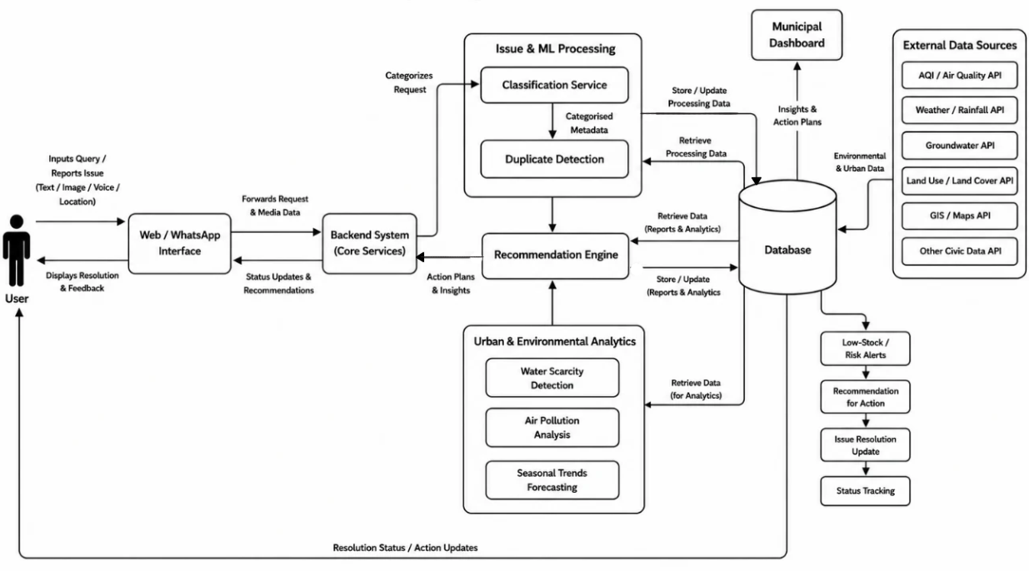
System Architecture

Slide 15
System Requirements
Hardware Requirements
Processor: 64-bit multi-core processor
RAM: 16 GB minimum
Storage: 20 GB for datasets and model checkpoints
Internet: Required for cloud storage/API access
Software Requirements
Operating System: Windows / Linux /MacOS
Frontend: React.js
Backend: Node.js, Express.js
AI/ML: PyTorch, Scikit-learn, Hugging Face, OpenCV, Sentence-Transformers
GIS: QGIS, GeoPandas, Folium, Rasterio, OpenStreetMap
Database: MongoDB
APIs & Services: Twilio WhatsApp API, Map APIs, Environmental Data APIs

Slide 16
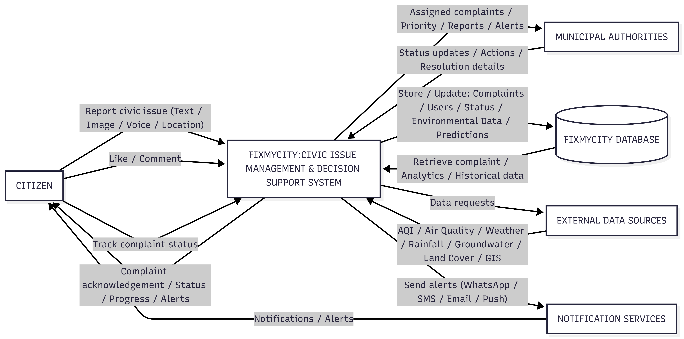
Design Methodology
Data Flow Diagram Level-0

Slide 17
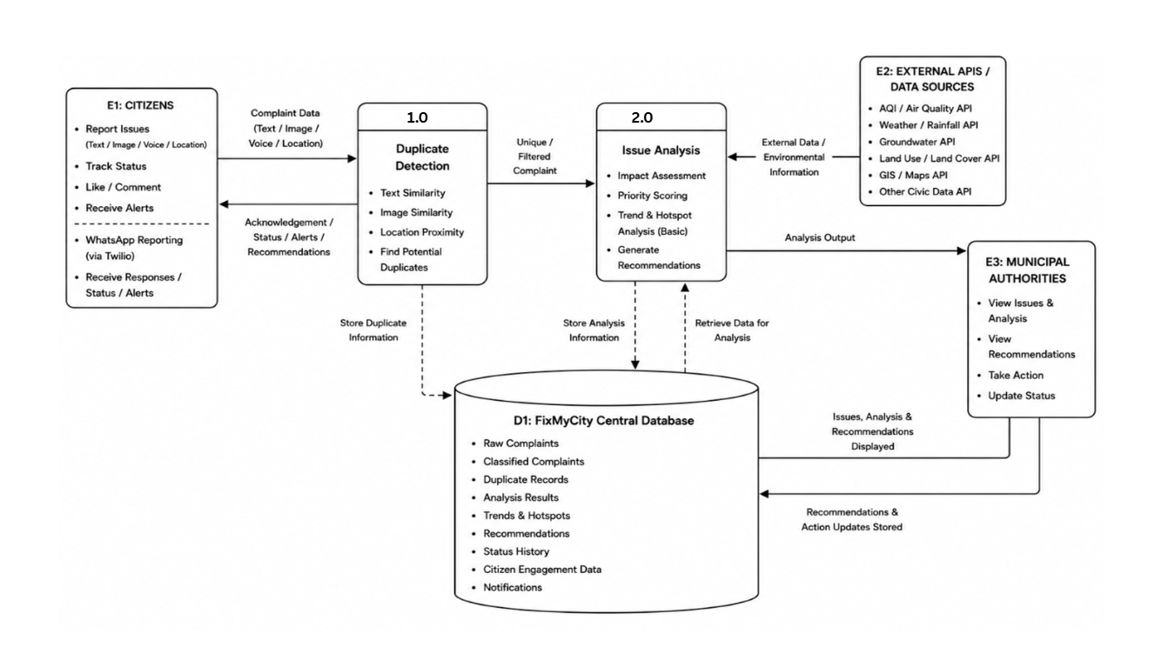
Data Flow Diagram Level-1

Slide 18
Process Logic
Receive citizen complaint through Web Application / WhatsApp.
Validate and preprocess text, images, voice, and location.
Classify and verify the civic issue using AI/ML.
Detect duplicate complaints using multimodal and spatial similarity.
Calculate priority score using severity, impact, engagement, recurrence, and environmental risk.
Route complaint to the appropriate municipal department.
Perform GIS-based spatial and temporal analysis to identify hotspots.
Forecast seasonal issues, air-quality risks, and water-related risks.
Generate explainable recommendations and preventive action plans.
Track resolution, update citizens, and continuously improve urban intelligence.

Slide 19
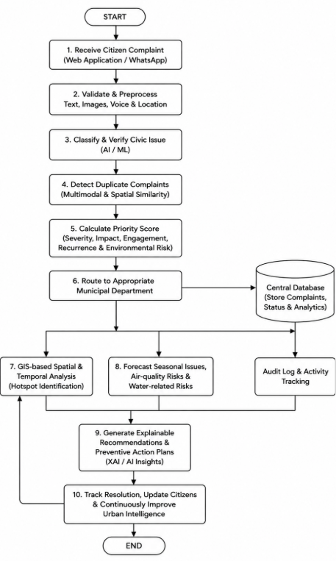
Activity Diagram

Slide 20
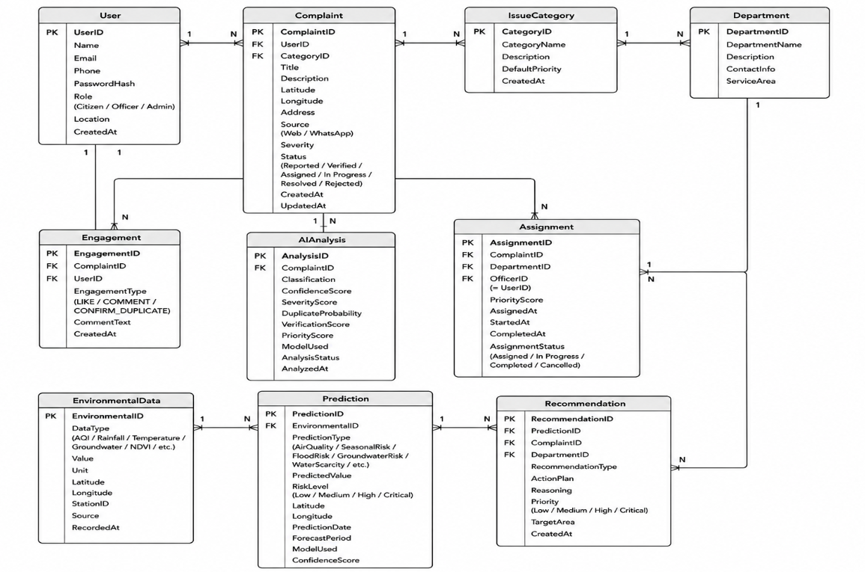
Database/Schema

Slide 21
Implementation & Status
Current Status
Problem statement and project objectives finalized
Literature survey and research gap analysis completed
FixMyCity overall methodology finalized
System requirements and technology stack identified
System architecture and overall workflow designed
Level-0 and Level-1 DFDs prepared
Process flow and database structure designed
CPCB Air Quality Data, OpenAQ, IMD Gridded Rainfall, India Flood Inventory (IFI), CGWB Groundwater Data datasets collected
Initial dataset organization and class identification completed
Implementation workflow and module sequence finalized

Slide 22
To Be Implemented Next
Citizen complaint reporting module with text, image, voice and location
WhatsApp chatbot and multilingual complaint processing
NLP, OCR and Speech-to-Text based complaint analysis
Computer vision for civic infrastructure defect detection
Multimodal duplicate complaint detection using text, image and location
AI-based dynamic complaint prioritization and departmental routing
GIS-based complaint mapping and spatio-temporal hotspot analysis
Predictive analytics for seasonal civic issues and preventive maintenance
Air pollution analytics and AQI forecasting module
Groundwater prediction and water-resource management module
Explainable AI-based decision-support and recommendation engine
Authority and citizen dashboards with real-time complaint tracking

Slide 23
REFERENCES
[1] Farhatun Shama, Abdul Aziz, Lamisa Bintee Mizan Deya, CitySolution: A complaining task distributive mobileapplication for smart city corporation using deep learning, SoftwareX, Volume 27,2024,101829,ISSN2352-7110, https://doi.org/10.1016/j.softx.2024.101829.https://www.sciencedirect.com/science/article/pii/S235271102400
[2] Kurian Binu, Vinay K, Midhun R, Athul V Pillai, Shereena Thampi, 2026, Smartreporter – A Crowdsourced Complaint Resolution System, INTERNATIONAL JOURNAL OF ENGINEERING RESEARCH & TECHNOLOGY (IJERT) Volume 15, Issue 01 , January – 2026, 10.17577/IJERTV15IS010067
[3] Arya, Deeksha, et al. "Global road damage detection: State-of-the-art solutions." 2020 IEEE international conference on big data (big data). IEEE, 2020.
[4] Reimers, Nils, and Iryna Gurevych. "Sentence-bert: Sentence embeddings using siamese bert-networks." Proceedings of the 2019 conference on empirical methods in natural language processing and the 9th international joint conference on natural language processing (EMNLP-IJCNLP). 2019.
[5]Radford,Alec,et al. "Learning transferable visual models from natural language supervision." International conference on machine learning. PmLR, 2021.

Slide 24
[6] Santana, Eduardo Felipe Zambom, et al. "Software platforms for smart cities: Concepts, requirements, challenges, and a unified reference architecture." arXiv preprint arXiv:1609.08089 (2016).
[7] Li, W., Goodchild, M. F., & Xu, B. (Eds.). (2021). GeoAI: Where machine learning and big data converge in GIScience. Springer. https://doi.org/10.1007/978-3-030-89879-5
[8] AI-Based Smart Civic Complaint Management System. (2026). International Journal of Engineering & Extended Technologies Research (IJEETR), 8(2), 4269-4281. https://doi.org/10.15662/IJEETR.2026.0802433
[9] S. Du, T. Li, Y. Yang and S. -J. Horng, "Deep Air Quality Forecasting Using Hybrid Deep Learning Framework," in IEEE Transactions on Knowledge and Data Engineering, vol. 33, no. 6, pp. 2412-2424, 1 June 2021, doi: 10.1109/TKDE.2019.2954510
[10] Kanito, D.; Benaafi, M.; Baalousha, H.M. Machine Learning Models for Groundwater Level Prediction and Uncertainty Analysis in Ruataniwha Basin, New Zealand. Hydrology 2025, 12, 282. https://doi.org/10.3390/hydrology12110282
[11] Lundberg, Scott M., and Su-In Lee. "A unified approach to interpreting model predictions." Advances in neural information processing systems 30 (2017).
[12] Pak, B., Chua, A., & Vande Moere, A. (2017). FixMyStreet Brussels: socio-demographic inequality in crowdsourced civic participation. Journal of Urban Technology, 24(2), 65-87.

Slide 25
[13] Matthews, P., Parsons, A., Nyanzu, E., & Rae, A. (2023). Dog fouling and potholes: understanding the role of coproducing ‘citizen sensors’ in local governance. Local Government Studies, 49(5), 908–931. https://doi.org/10.1080/03003930.2022.2116575
[14] Salcedo, E., Jaber, M., & Requena Carrión, J. (2022). A Novel Road Maintenance Prioritisation System Based on Computer Vision and Crowdsourced Reporting. Journal of Sensor and Actuator Networks, 11(1), 15. https://doi.org/10.3390/jsan11010015
[15] Wang, Z., Wu, X., & Wu, Y. (2023). A spatiotemporal XGBoost model for PM2.5 concentration prediction and its application in Shanghai. Heliyon, 9(12), e22569. https://doi.org/10.1016/j.heliyon.2023.e22569
[16] Gokul, P. R., Mathew, A., Bhosale, A., & Nair, A. T. (2023). Spatio-temporal air quality analysis and PM2.5 prediction over Hyderabad City, India using artificial intelligence techniques. Ecological Informatics, 76, 102067. https://doi.org/10.1016/j.ecoinf.2023.102067

Slide 26
THANK YOU

